Slide 1
CSE 3400/CSE 5850 - Introduction to Cryptography and Cybersecurity / Introduction to Cybersecurity Lecture 9 Shared Key Protocols – Part II
Ghada Almashaqbeh
UConn
Adapted from the Textbook Slides

Slide 2
Outline
Handshake protocol extensions.
Key distribution centers.
Improving resiliency to key exposure.
2

Slide 3
Handshake Protocol Extensions
3

Slide 4
Authenticated Request-Response Protocols
Beside authenticating entities, these protocols authenticate the exchange of a request and a response between the entities.
Required properties:
Request authentication.
The request was indeed sent by the sender.
Response authentication
The response was indeed sent by the receiver (to which the request was intended).
No replay.
Every request/response was received at most the number of times it was sent by the sender.
4

Slide 5
Authenticated Request-Response Protocols
Five variants:
2PP-RR
2PP stands for two party protocol, and RR stands for request-response.
2RT-2PP
2RT stands for 2 round trip.
Counter-based-RR
Time-based-RR
Key-exchange
5

Slide 6
2PP-RR
A three-flow nonce-based protocol.
Significant drawback:
The request is sent by the responder and the initiator sends the response.
So initiator must wait for a request rather than sending it!!
6
Notes:
6
(c) Amir Herzberg, http://AmirHerzberg.com, Bar Ilan University
11/13/11

Slide 7
2RT-2PP
A four-flow nonce-based protocol.
Mainly fixes the drawback of 2PP-RR discussed in the previous slide.
7
Notes:
7
(c) Amir Herzberg, http://AmirHerzberg.com, Bar Ilan University
11/13/11

Slide 8
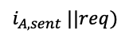
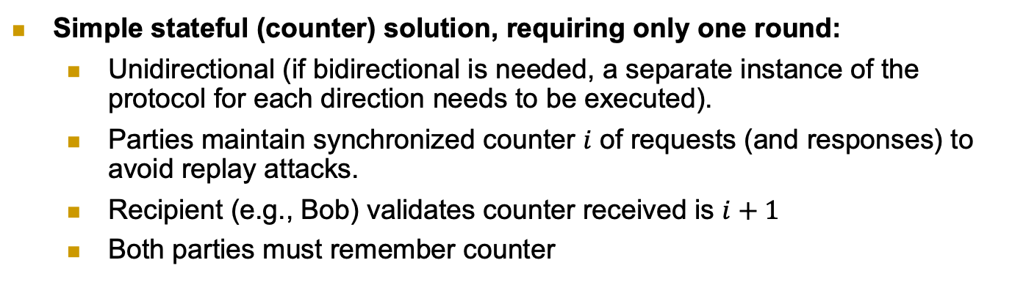
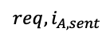


Counter-Based Authenticated RR
Simple stateful (counter) solution, requiring only one round:
Unidirectional (if bidirectional is needed, a separate instance of the protocol for each direction needs to be executed).
Parties maintain synchronized counter $i$ of requests (and responses) to avoid replay attacks.
Recipient (e.g., Bob) validates counter received is $i+1$
Both parties must remember counter
$$i_{}$$
$$i_{A,sent}$$
$$req,i_{A,sent}$$
$$i_{A,sent} ||req)$$
8
Notes:
8
(c) Amir Herzberg, http://AmirHerzberg.com, Bar Ilan University
11/13/11

Slide 9
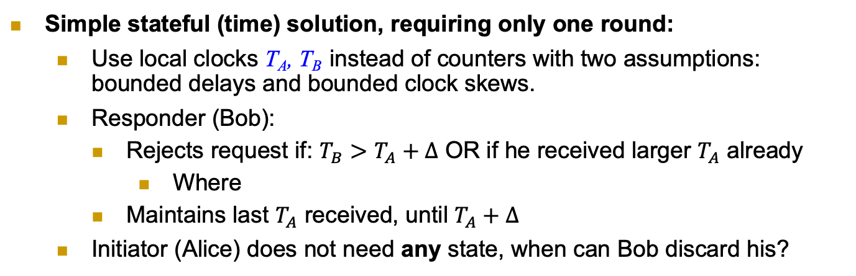
Time-Based Authenticated RR
Simple stateful (time) solution, requiring only one round:
Use local clocks T_{A}, T_{B} instead of counters with two assumptions: bounded delays and bounded clock skews.
Responder (Bob):
Rejects request if: $T_{B}>T_{A}+Δ$ OR if he received larger $T_{A}$ already
Where
Maintains last $T_{A}$ received, until $T_{A}+Δ$
Initiator (Alice) does not need any state, when can Bob discard his?
Remember T_{A}
9
Notes:
9
(c) Amir Herzberg, http://AmirHerzberg.com, Bar Ilan University
11/13/11

Slide 10
2RT-2PP with Confidentiality
Secure connection: authentication, freshness, secrecy
Independent keys: for encryption k.e, for authentication: k.a
How can we derive them both from a single key k ? The PRF idea from before:
k.e=PRF_{k}(“Encrypt”), k.a=PRF_{k}(“MAC”)
Hmm… same key encrypts all messages, in all sessions ☹
Can we improve security, by changing keys, e.g., between sessions ?
Alice
Bob
A, N_{A}
N_{B}
E_{k.e}(req) , Mac_{k.a}(3 || A→B || N_{A} || N_{B} || E_{k.e}(req) )
E_{k.e}(resp) , Mac_{k.a}(4 || A←B ||N_{A} || N_{B} || E_{k.e}(resp))
10
Notes:
10
(c) Amir Herzberg, http://AmirHerzberg.com, Bar Ilan University
11/13/11

Slide 11
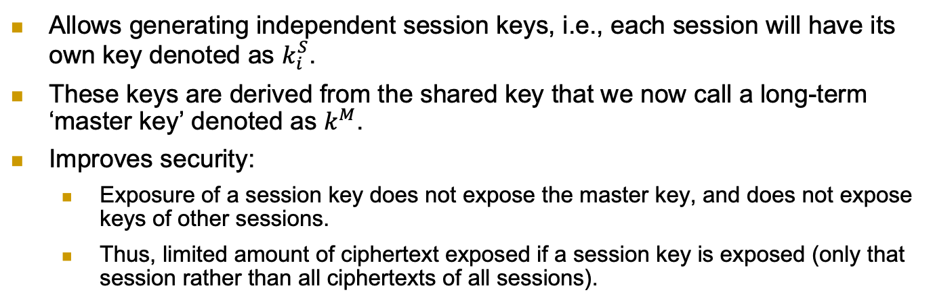
2PP Key Exchange Protocol
Allows generating independent session keys, i.e., each session will have its own key denoted as $k_{i}^{S}$.
These keys are derived from the shared key that we now call a long-term ‘master key’ denoted as $k^{M}$.
Improves security:
Exposure of a session key does not expose the master key, and does not expose keys of other sessions.
Thus, limited amount of ciphertext exposed if a session key is exposed (only that session rather than all ciphertexts of all sessions).
A PRF is used instead of a MAC, is that ok?
11
Notes:
11
(c) Amir Herzberg, http://AmirHerzberg.com, Bar Ilan University
11/13/11

Slide 12
Key Distribution Centers (KDCs) Establish a shared key between two or more entities, usually with the help of a trusted third party referred to as KDC
12

Slide 13
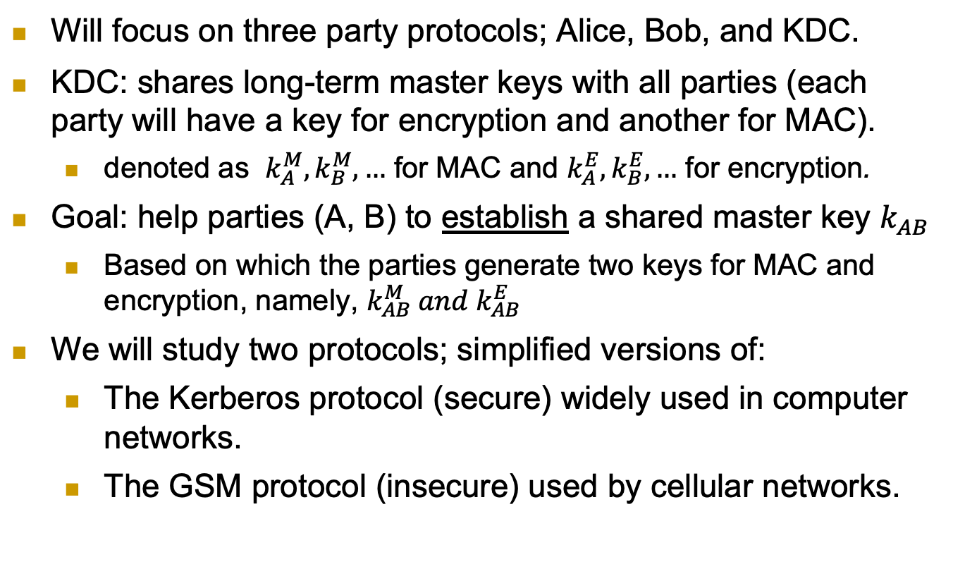
Key Distribution Center (KDC)
Will focus on three party protocols; Alice, Bob, and KDC.
KDC: shares long-term master keys with all parties (each party will have a key for encryption and another for MAC).
denoted as $k_{A}^{M}, k_{B}^{M}, …$ for MAC and $k_{A}^{E}, k_{B}^{E}, …$ for encryption.
Goal: help parties (A, B) to establish a shared master key $k_{AB}$
Based on which the parties generate two keys for MAC and encryption, namely, $k_{AB}^{M} and k_{AB}^{E}$
We will study two protocols; simplified versions of:
The Kerberos protocol (secure) widely used in computer networks.
The GSM protocol (insecure) used by cellular networks.
13
Notes:
KDC = TGS (Ticket Granting Server) [Kerberos]

Slide 14
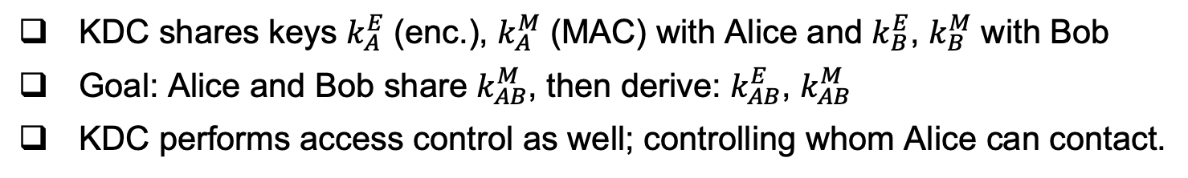
The Kerberos KDC Protocol
KDC shares keys $k_{A}^{E}$ (enc.), $k_{A}^{M}$ (MAC) with Alice and $k_{B}^{E}$, $k_{B}^{M}$ with Bob
Goal: Alice and Bob share $k_{AB}^{M}$, then derive: $k_{AB}^{E}$, $k_{AB}^{M}$
KDC performs access control as well; controlling whom Alice can contact.
14

Slide 15
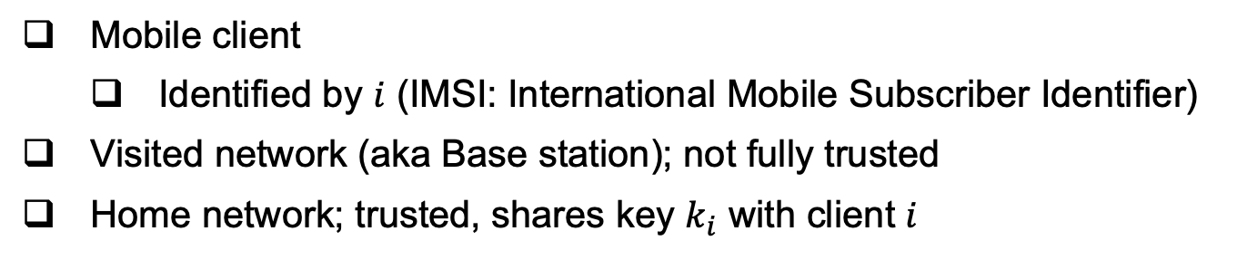
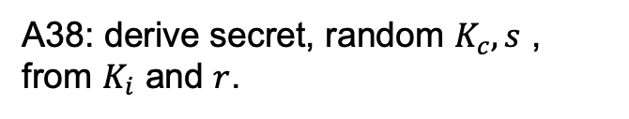
The GSM Handshake Protocol
Mobile client
Identified by $i$ (IMSI: International Mobile Subscriber Identifier)
Visited network (aka Base station); not fully trusted
Home network; trusted, shares key $k_{i}$ with client $i$
A38: derive secret, random $K_{c}, s$ , from $K_{i}$ and $r$.
GSM spec: OWF, but really should be a PRF!
15

Slide 16
Example – Sending two messages
K_{c} is the session key
s is a secret authenticator
A5: provide ‘pad’ for encryption
Several variants: A5/1 - `regular’
A5/2 - `weak’
A5/3 – more secure
Really should be a PRF!
ECC: error correcting code. Used to allow recovery from errors.
(… and so on for more messages)
16

Slide 17
Attacks on GSM Handshake Protocol
We will explore two attacks:
Visited network impersonation replay attack.
We will study this one in detail.
Ciphersuite downgrade attack.
Only high level description.
17
Notes:
KDC = TGS (Ticket Granting Server) [Kerberos]

Slide 18
Visited-network Impersonation Attack
Note: does NOT
Impersonate mobile, only Visited network.
In the cryptanalysis phase, the attacker exposes Kc based on the cyphertexts it collected in the eavesdropping phase (recall A5/1 and A5/2 are not secure).
In the impersonate phase, the attacker will send the same r and s from before (replay attack), which will lead to the same Kc he obtained in the cryptanalysis phase.
18

Slide 19
GSM Ciphersuites Downgrade Attack
A ciphersuite is the set of cryptographic schemes used in a protocol execution.
Ciphersuite negotiation:
Mobile sends a list of cipher-suites it supports
Visited-network selects best one (the strongest/most secure) that it also supports
Goal of negotiation is to support interoperability between devices of different capabilities.
GSM encryption algorithms $E_{k}$:
A5/0: none, A5/1: broken, A5/2: useless (break with only 1sec), A5/3: ‘other’
A MitM attacker may trick these parties to use a weak suite although the parties can support a stronger one.
It works due to key reuse in GSM (same key is used across various encryption schemes).
For full details, see the textbook.
19

Slide 20
Improving Resiliency to Key Exposure
20

Slide 21
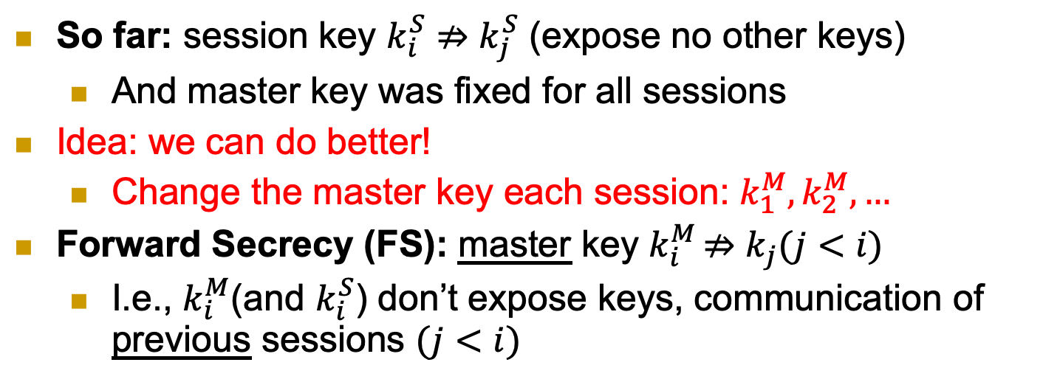
Forward Secrecy
So far: session key $k_{i}^{S}⇏k_{j}^{S}$ (expose no other keys)
And master key was fixed for all sessions
Idea: we can do better!
Change the master key each session: $k_{1}^{M}, k_{2}^{M}, …$
Forward Secrecy (FS): master key $k_{i}^{M}$ $⇏k_{j}(j<i)$
I.e., $k_{i}^{M}$(and $k_{i}^{S}$) don’t expose keys, communication of previous sessions $(j<i)$
21
Notes:
21
(c) Amir Herzberg, http://AmirHerzberg.com, Bar Ilan University
11/13/11
`Perfect’ is not really the right term… but that’s the commonly used term.

Slide 22
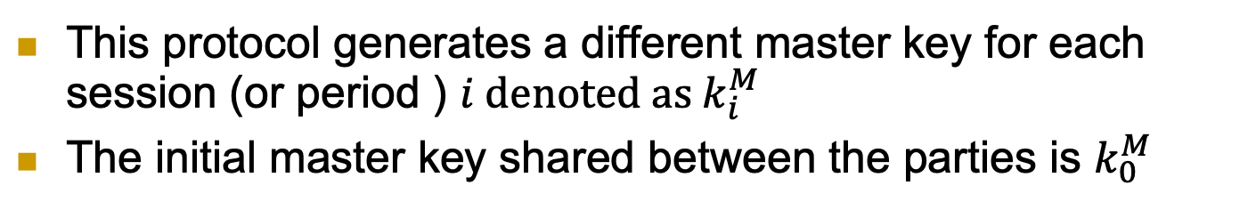
Forward Secrecy 2PP Key Exchange
This protocol generates a different master key for each session (or period ) $i denoted as k_{i}^{M}$
The initial master key shared between the parties is $k_{0}^{M}$
22
Notes:
22
(c) Amir Herzberg, http://AmirHerzberg.com, Bar Ilan University
11/13/11
`Perfect’ is not really the right term… but that’s the commonly used term.

Slide 23
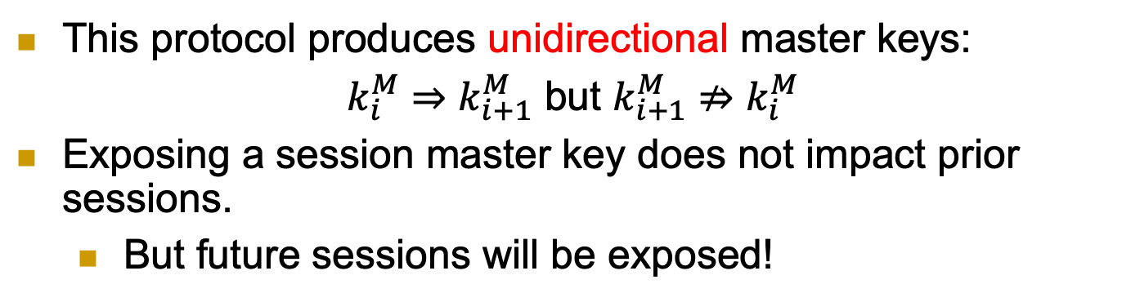
Forward Secrecy 2PP Key Exchange
This protocol produces unidirectional master keys:
$k_{i}^{M}⇒k_{i+1}^{M}$ but $k_{i+1}^{M}⇏k_{i}^{M}$
Exposing a session master key does not impact prior sessions.
But future sessions will be exposed!
23
Notes:
23
(c) Amir Herzberg, http://AmirHerzberg.com, Bar Ilan University
11/13/11
`Perfect’ is not really the right term… but that’s the commonly used term.

Slide 24
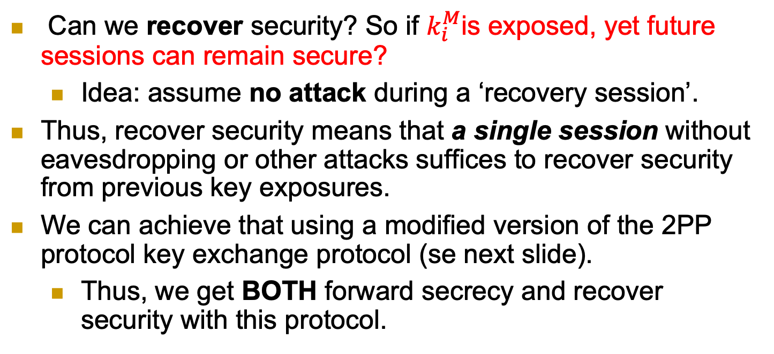
Recover Security (RS)
Can we recover security? So if $k_{i}^{M}$is exposed, yet future sessions can remain secure?
Idea: assume no attack during a ‘recovery session’.
Thus, recover security means that a single session without eavesdropping or other attacks suffices to recover security from previous key exposures.
We can achieve that using a modified version of the 2PP protocol key exchange protocol (se next slide).
Thus, we get BOTH forward secrecy and recover security with this protocol.
24
Notes:
24
(c) Amir Herzberg, http://AmirHerzberg.com, Bar Ilan University
11/13/11
`Perfect’ is not really the right term… but that’s the commonly used term.

Slide 25
2PP Key Exchange with RS and FS
Run the 2PP key exchange protocol from before but generate the master session keys in a slightly different way.
And of course, you get recover security if there is a single session that is attack free.
So now generating a session master key not only requires prior session master key but also the random nonces that the parties exchanged in the session (as part of the 2PP protocol).
25
Notes:
25
(c) Amir Herzberg, http://AmirHerzberg.com, Bar Ilan University
11/13/11
`Perfect’ is not really the right term… but that’s the commonly used term.

Slide 26
Covered Material From the Textbook
Chapter 5
Section 5.3
Section 5.4
Section 5.5
Except Sections 5.5.4 and 5.5.5 (only what we covered in class about these sections)
Section 5.6
Except Section 5.6.3

Slide 27

Thank You!

